Slide 1
Algorithms and Data Structures
Lecture X
Simonas Šaltenis
Nykredit Center for Database Research
Aalborg University
simas@cs.auc.dk

Slide 2
This Lecture
Dynamic programming
  Fibonacci numbers example
  Optimization problems
  Matrix multiplication optimization
  Principles of dynamic programming
  Longest Common Subsequence

Slide 3
What have we learned? (1)
Ways of reasoning about algorithms:
  Correctness
  Concrete and asymptotic running time
Data structures and algorithms for implementing sorted and unsorted dictionary ADTs:
  Hashing
  Binary trees, Red-Black trees
  Data structures for secondary storage (B-trees)

Slide 4
What have we learned? (2)
Examples of classic algorithms:
  Searching (binary search)
  Sorting (selection sort, insertion sort, heap-sort, merge-sort, quick-sort)
Algorithm design techniques:
  Iterative algorithms
  Divide-and-conquer algorithms

Slide 5
Divide and Conquer
Divide and conquer method for algorithm design:
  Divide: If the input size is too large to deal with in a straightforward manner, divide the problem into two or more disjoint subproblems
  Conquer: Use divide and conquer recursively to solve the subproblems
  Combine: Take the solutions to the subproblems and “merge” these solutions into a solution for the original problem

Slide 6
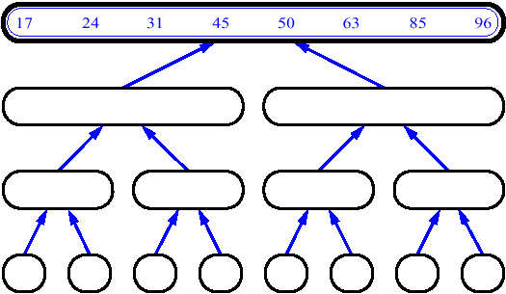
Divide and Conquer (2)
For example, MergeSort
The subproblems are independent, all different
Merge-Sort(A, p, r)
if p < r then
q←(p+r)/2
Merge-Sort(A, p, q)
Merge-Sort(A, q+1, r)
Merge(A, p, q, r)

Slide 7
Fibonacci Numbers
F_{n}= F_{n-1}+ F_{n-2}
F₀ =0, F₁ =1
  0, 1, 1, 2, 3, 5, 8, 13, 21, 34 …
Straightforward recursive procedure is slow!
Why? How slow?
Let’s draw the recursion tree

Slide 8
Fibonacci Numbers (2)
F(6) = 8
F(5)
F(4)
F(4)
F(3)
F(3)
F(2)
F(3)
F(2)
F(2)
F(1)
F(2)
F(1)
F(1)
F(0)
F(2)
F(1)
F(1)
F(0)
F(1)
F(0)
F(1)
F(0)
F(1)
F(0)
We keep calculating the same value over and over!

Slide 9
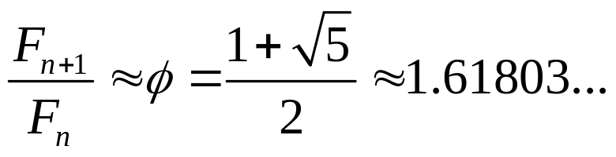
Fibonacci Numbers (3)
How many summations are there?
Golden ratio
Thus F_{n}≈1.6^{n}
Our recursion tree has only 0s and 1s as leaves, thus we have ≈1.6^{n} summations
Running time is exponential!

Slide 10
Fibonacci Numbers (4)
We can calculate F_{n} in linear time by remembering solutions to the solved subproblems – dynamic programming
Compute solution in a bottom-up fashion
Trade space for time!
  In this case, only two values need to be remembered at any time (probably less than the depth of your recursion stack!)
Fibonacci(n)
F₀←0
F₁←1
for i ← 1 to n do
F_{i} ← F_{i-1} + F_{i-2}

Slide 11
Optimization Problems
We have to choose one solution out of many – a one with the optimal (minimum or maximum) value.
A solution exhibits a structure
  It consists of a string of choices that were made – what choices have to be made to arrive at an optimal solution?
The algorithms computes the optimal value plus, if needed, the optimal solution

Slide 12
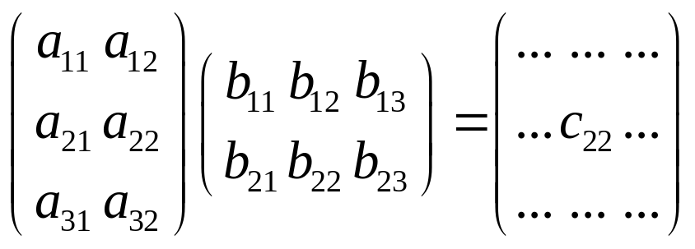
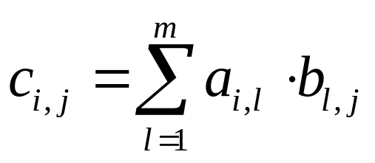
Multiplying Matrices
Two matrices, A – n×m matrix and B – m×k matrix, can be multiplied to get C with dimensions n×k, using nmk scalar multiplications
Problem: Compute a product of many matrices efficiently
Matrix multiplication is associative
  (AB)C = A(BC)

Slide 13
Multiplying Matrices (2)
The parenthesization matters
Consider A×B×C×D, where
  A is 30×1, B is 1×40, C is 40×10, D is 10×25
Costs:
  (AB)C)D = 1200 + 12000 + 7500 = 20700
  (AB)(CD) = 1200 + 10000 + 30000 = 41200
  A((BC)D) = 400 + 250 + 750 = 1400
We need to optimally parenthesize

Slide 14
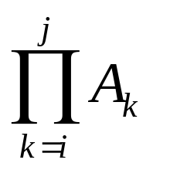
Multiplying Matrices (3)
Let M(i,j) be the minimum number of multiplications necessary to compute
Key observations
  The outermost parenthesis partition the chain of matrices (i,j) at some k, (i≤k<j): (A_{i}… A_{k})(A_{k+1}… A_{j})
  The optimal parenthesization of matrices (i,j) has optimal parenthesizations on either side of k: for matrices (i,k) and (k+1,j)

Slide 15
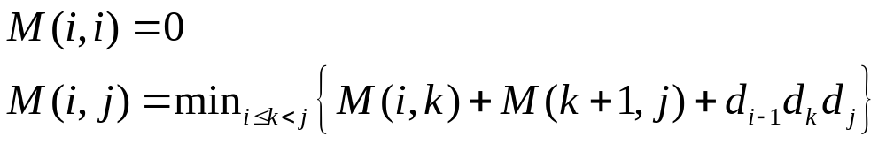
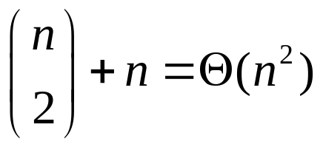
Multiplying Matrices (4)
We try out all possible k. Recurrence:
A direct recursive implementation is exponential – there is a lot of duplicated work (why?)
But there are only different subproblems (i,j), where 1≤ i ≤ j ≤ n

Slide 16
Multiplying Matrices (5)
Thus, it requires only Θ(n²) space to store the optimal cost M(i,j) for each of the subproblems: half of a 2d array M[1..n,1..n]
Matrix-Chain-Order(d₀…d_{n})
1 for i←1 to n do
2 M[i,i] ← 0
3 for l←2 to n do
4 for i←1 to n-l+1 do
5 j ← i+l-1
M[i,j] ← ∞
for k←i to j-l do
q ← M[i,k]+M[k+1,j]+d_{i-1}d_{k}d_{j}
9 if q < M[i,j] then
M[i,j] ← q
c[i,j] ← k
12 return M, c

Slide 17
Multiplying Matrices (6)
After execution: M[1,n] contains the value of the optimal solution and c contains optimal subdivisions (choices of k) of any subproblem into two subsubproblems
A simple recursive algorithm Print-Optimal-Parents(c, i, j) can be used to reconstruct an optimal parenthesization
Let us run the algorithm on d = [10, 20, 3, 5, 30]

Slide 18
Multiplying Matrices (7)
Running time
  It is easy to see that it is O(n³)
  It turns out, it is also Ω(n³)
From exponential time to polynomial

Slide 19
Memoization
If we still like recursion very much, we can structure our algorithm as a recursive algorithm:
  Initialize all M elements to ∞ and call Lookup-Chain(d, i, j)
Lookup-Chain(d,i,j)
1 if M[i,j] < ∞ then
2 return m[i,j]
3 if i=j then
m[i,j] ←0
5 else for k ← i to j-1 do
q ← Lookup-Chain(d,i,k)+ Lookup-Chain(d,k+1,j)+d_{i-1}d_{k}d_{j}
7 if q < M[i,j] then
8 M[i,j] ← q
9 return M[i,j]

Slide 20
Dynamic Programming
In general, to apply dynamic programming, we have to address a number of issues:
  1. Show optimal substructure – an optimal solution to the problem contains within it optimal solutions to sub-problems
    Solution to a problem:
      Making a choice out of a number of possibilities (look what possible choices there can be)
      Solving one or more sub-problems that are the result of a choice (characterize the space of sub-problems)
    Show that solutions to sub-problems must themselves be optimal for the whole solution to be optimal (use “cut-and-paste” argument)

Slide 21
Dynamic Programming (2)
  2. Write a recurrence for the value of an optimal solution
    M_{opt} = Min_{over all choices k} {(Sum of M_{opt} of all sub-problems, resulting from choice k) + (the cost associated with making the choice k)}
  Show that the number of different instances of sub-problems is bounded by a polynomial

Slide 22
Dynamic Programming (3)
  3. Compute the value of an optimal solution in a bottom-up fashion, so that you always have the necessary sub-results pre-computed (or use memoization)
  See if it is possible to reduce the space requirements, by “forgetting” solutions to sub-problems that will not be used any more
  4. Construct an optimal solution from computed information (which records a sequence of choices made that lead to an optimal solution)

Slide 23
Longest Common Subsequence
Two text strings are given: X and Y
There is a need to quantify how similar they are:
  Comparing DNA sequences in studies of evolution of different species
  Spell checkers
One of the measures of similarity is the length of a Longest Common Subsequence (LCS)

Slide 24
LCS: Definition
Z is a subsequence of X, if it is possible to generate Z by skipping some (possibly none) characters from X
For example: X =“ACGGTTA”, Y=“CGTAT”, LCS(X,Y) = “CGTA” or “CGTT”
To solve LCS problem we have to find “skips” that generate LCS(X,Y) from X, and “skips” that generate LCS(X,Y) from Y

Slide 25
LCS: Optimal Substructure
We make Z to be empty and proceed from the ends of X_{m}=“x₁ x₂ …x_{m}” and Y_{n}=“y₁ y₂ …y_{n}”
  If x_{m}=y_{n}, append this symbol to the beginning of Z, and find optimally LCS(X_{m-1}, Y_{n-1})
  If x_{m}≠y_{n},
    Skip either a letter from X
    or a letter from Y
    Decide which decision to do by comparing LCS(X_{m}, Y_{n-1}) and LCS(X_{m-1}, Y_{n})
  “Cut-and-paste” argument

Slide 26
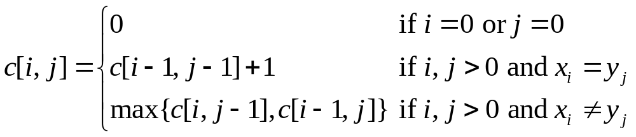
LCS: Reccurence
The algorithm could be easily extended by allowing more “editing” operations in addition to copying and skipping (e.g., changing a letter)
Let c[i,j] = LCS(X_{i}, Y_{j})
Observe: conditions in the problem restrict sub-problems (What is the total number of sub-problems?)

Slide 27
LCS: Compute the Optimum
LCS-Length(X, Y, m, n)
1 for i←1 to m do
2 c[i,0] ← 0
3 for j←0 to n do
4 c[0,j] ← 0
5 for i←1 to m do
6 for j←1 to n do
7 if x_{i} = y_{j} then
c[i,j] ← c[i-1,j-1]+1
9 b[i,j] ← ”copy”
10 else if c[i-1,j] ≥ c[i,j-1] then
c[i,j] ← c[i-1,j]
b[i,j] ← ”skipx”
13 else
c[i,j] ← c[i,j-1]
b[i,j] ← ”skipy”
16 return c, b

Slide 28
LCS: Example
Lets run: X =“ACGGTTA”, Y=“CGTAT”
How much can we reduce our space requirements, if we do not need to reconstruct LCS?

Slide 29
Next Lecture
Graphs:
  Representation in memory
  Breadth-first search
  Depth-first search
  Topological sort

